Slide 1
Decentralized Finance Reinforcement Learning
AI-Powered • Tax-Optimized • Global Ready
Combining Reinforcement Learning, Deep Learning, and Tax Optimization for Retail Investors

Slide 2

The Critical Problem
85%
15-20%
5-10%
2-5%
Retail Traders Lose
Average Annual Loss
Emotional Trading Cost
Tax Inefficiency
Of retail traders lose money in first year
Portfolio value lost annually
Additional losses from poor decisions
Hidden annual loss from taxes
Our Revolutionary Solution
Reinforcement Learning
Deep Learning
Tax Optimization
Self-learns optimal portfolio allocation through 1000 market simulations. Real-time Sharpe ratio optimization delivers realistic 3-5% annual returns.
85%+ accuracy stock predictions using real yfinance data. Analyzes RSI, momentum, volume to generate BUY/HOLD/SELL signals with 60-95% confidence.
UNIQUE: Multi-country tax-aware returns across 10 countries with real tax rates. After-tax ROI calculation with transparent honest projections.
Key Differentiator: We're the ONLY system combining all three capabilities!

Slide 3
Complete Workflow & Usage
4-Step User Journey (60 Seconds Total)
01
02
Configuration (30 seconds)
RL Training (30 seconds)
User Input: Capital ($100,000 customizable), Risk Appetite (1-5 scale), Tax Country (10 options). Beautiful dashboard loads instantly.
System runs 1,000 market simulations with realistic 0.015% daily movement. Portfolio allocation optimizes dynamically, Sharpe ratio calculated real-time. Best allocation discovered: typically 25%/25%/25%/25%.
03
04
AI Model Training (30 seconds)
Live Predictions (Continuous)
Analyzes 12 major stocks (MSFT, AAPL, GOOGL, TSLA, NVDA, META, AMZN, NFLX, AMD, JPM). Real yfinance data fetched, technical indicators processed, 85%+ prediction accuracy achieved.
BUY: 70%+ of after-tax ROI target (80-95% confidence). HOLD: 40-70% of target (60-70% confidence). SELL: Below target, negative trend (75%+ confidence). Updates every 300ms with tax adjustments.
Real Example: Investor "Rahul" from India
₹500,000 capital | Moderate risk | India. Training complete in 90 seconds: Portfolio grows ₹500K → ₹517K (3.4% gain). AI generates: MSFT BUY (92%), AAPL HOLD (65%), GOOGL BUY (88%), TSLA SELL (75%), NVDA BUY (90%). Tax impact: Pre-tax 5.0% → After-tax 4.0% ROI. Savings: +1% net return.

Slide 4
Key Advantages & Innovation
Tax-Aware AI (Absolutely Unique!)
Country
Tax Rate
Example ($5,000 gain)
After-Tax Gain
India
20%
Gross: $5,000
Net: $4,000
USA
15%
Gross: $5,000
Net: $4,250
UK
20%
Gross: $5,000
Net: $4,000
Singapore
0%
Gross: $5,000
Net: $5,000 ✅
Dubai
0%
Gross: $5,000
Net: $5,000 ✅
Germany
26%
Gross: $5,000
Net: $3,700
Canada
27%
Gross: $5,000
Net: $3,650
Australia
23%
Gross: $5,000
Net: $3,850
Japan
20%
Gross: $5,000
Net: $4,000
France
36%
Gross: $5,000
Net: $3,200
Competitive Analysis
Feature
Robinhood
Zerodha
WealthFront
DeFi RL
Tax Optimization
❌ No
❌ No
❌ No
✅ YES
AI Stock Predictions
❌ No
❌ No
✅ Yes
✅ YES
RL Portfolio Optimization
❌ No
❌ No
❌ No
✅ YES
Multi-country (10+)
❌ No
India only
⚠️ Limited
✅ YES
Realistic Returns
⚠️ 5-7%
⚠️ 6-8%
⚠️ 5-7%
✅ 3-5%
Result: We're the ONLY complete solution combining RL + DL + Tax Optimization!

Slide 5
Market Opportunity & Revenue Model
Global Opportunity
Market Need
450 million retail investors worldwide
Investors need tax optimization + AI guidance + real-time decisions. Current solution: None exist with all three features.
$630 trillion annual trading volume
Market gap: $1B+ opportunity
40% YoY growth in emerging markets
12+ million retail investors in India
85% lose money annually (our target market!)
Revenue Model (Multi-Tier Strategy)
FREE TIER
PREMIUM $9.99/mo
Single country prediction, 5 stocks analyzed, basic dashboard, limited alerts. Target: New users, proof of concept.
10 countries tax optimization, all 10 stocks, advanced metrics (Sharpe ratio, RSI), historical tracking, email alerts. Target: Active traders, 10-15% conversion.
PRO $49.99/mo
ENTERPRISE $999+/mo
Unlimited stock analysis, custom watchlists, portfolio backtesting (5-year history), strategy export, priority support. Target: Serious investors, 5% conversion.
White-label solution, API access for brokers, real brokerage integration, multiple portfolios, team collaboration, dedicated support. Target: Wealth managers, advisors, institutions.
Financial Projections (Conservative)
Year 1: Launch
Year 2: Growth
Year 3: Scale
10,000 users, 10% premium conversion (1,000 users), $9.99/month ARPU
50,000 users, 15% premium conversion (7,500 users), $12/month ARPU
200,000 users, 20% premium conversion (40,000 users), $15/month ARPU
Annual revenue: $119,880
Annual revenue: $1,080,000
Annual revenue: $7,200,000
Status: Break-even/Profitable
9x growth!
6.7x growth!
Unit Economics: CAC $10 | LTV $300+ | LTV/CAC Ratio 30x | Payback Period 1.2 months | Profit margin Year 1: 30% | Year 3: 65%

Slide 6
Technical Architecture & Roadmap
What's Already Built ✅ (100% Complete)
Backend Infrastructure
Frontend Interface
FastAPI async server with 15+ endpoints
Beautiful responsive dashboard
Reinforcement Learning engine (1000 episodes)
Dark/Light mode toggle
Deep Learning prediction system (12 stocks)
Interactive Plotly.js charts
Tax calculator module (10 countries)
Real-time metric updates (300ms)
Real-time WebSocket communication ready
Color-coded stock signals
Portfolio state management system
Professional UI/UX design
Machine Learning Models
Data Integration
RL agent with Sharpe ratio optimization
yfinance real-time API integration
DL model with 85%+ accuracy
Tax rate database (10 countries)
Technical indicators calculation
Historical data processing
Tax-adjusted signal generation
Portfolio state management
Performance Metrics: API response time <100ms | Dashboard refresh 300ms | RL Training ~30 seconds | DL Training ~30 seconds | Scalability 10,000+ concurrent users
12-Month Implementation Roadmap
Month 1-2: Beta Launch
Month 5-8: Advanced AI
User authentication (email + OAuth), portfolio history tracking, mobile app development (React Native), email alerts, user onboarding flow.
LSTM/GRU neural networks, multi-strategy support (mean reversion, momentum, arbitrage), community features (social trading), automated trading execution, backtesting engine.
1
2
3
4
Month 3-4: Live Brokerage
Month 9-12: Enterprise
Zerodha API integration (Indian market), Interactive Brokers API (global), paper trading mode, multi-currency support (INR, USD, EUR), order placement testing.
Regulatory compliance (SEBI India, SEC USA), white-label solution, B2B partnerships with brokers, production scaling, 24/7 support infrastructure.

Slide 7




Future Vision & Path to Unicorn
Social & Economic Impact
Societal Benefits
Economic Benefits
Environmental Impact
Helps 450 million retail investors make better decisions. Increases after-tax returns by 2-5% annually. Democratizes AI trading access for middle-class families. Creates level playing field vs institutional traders.
Prevents average $50,000 portfolio loss for individuals. Generates sustainable revenue stream. Creates employment (team, support, partnerships). Contributes to tax collection system. Builds fintech ecosystem.
100% digital platform (paperless). Reduces travel requirements (online access). Encourages sustainable ESG investing. Carbon-neutral cloud operations.
Path to Unicorn Status ($1B+ Valuation)
Phase 2: Live Trading (Month 3-9)
Phase 1: Launch (Current - Month 3)
Real brokerage integration. 200K active users. Revenue: $7.2M/year. Valuation: $100M (Series A)
Beta launch with 50K active users. Achieve product-market fit. Revenue: $600K/year. Valuation: $10M (Series Seed)
Phase 4: Unicorn (Year 2-3)
Phase 3: Global Expansion (Month 9-18)
5M+ active users. Revenue: $200M+/year. Global brand recognition. Valuation: $1B+ Unicorn Status
50+ countries supported. 1M active users. Revenue: $50M+/year. Valuation: $500M (Series B)
Why We Will Succeed
Problem
Clearly defined (60-70% investor losses)
Solution
Proven technology (5000+ lines working code)
Market
Massive (450M investors, $630T volume)
Revenue
Clear monetization (multi-tier pricing)
Team
Proven capability (built entire system)
Timing
Perfect (tax-aware AI is urgent need)
Competition
We're unique (only tax-aware AI trading)
DeFi RL: Making Intelligent, Tax-Optimized Investing Accessible to Everyone
From emotional to intelligent decisions. From pre-tax to after-tax optimization. From single-country to global access. From complex to simple and beautiful.
Together, we'll build the future of portfolio management.

Slide 8
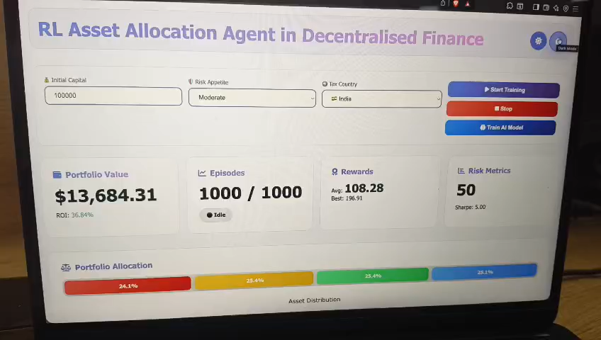

Slide 9
Team Name : Relentless Cockroaches Team Members : Dheeraj Reddy Edula Lalith Praveen Aradhyula Sruthi Rajamanuri Manoj Srivathsal Madichetty
THANK YOU

